Slide 1

Chapter 1
Introduction
1.<number>
Copyright © The McGraw-Hill Companies, Inc. Permission required for reproduction or display.
Notes:
1.#

Slide 2
1-1 DATA COMMUNICATIONS
Telecommunication
Communication at a distance.
Data
Information presented in whatever form.
Data communications
Exchange of data between two devices
Via some form of transmission medium
e.g. wire cable.
Topics discussed in this section:
Components
Data Representation
Data Flow
1.<number>
Notes:
1.#

Slide 3
1-1 Wireless DATA COMMUNICATIONS
Infra Red (IR)
Blue Tooth (2.4GHz [802.15.1])
Wifi (2.4GHz[802.11 b,g], 5GHz[802.11 a,e])
Cellular (900MHz , 1.8GHz)
WiMAX (2-11GHz , 5.8GHz[802.16] )
Satellite (Radio Signals)
_____ Licensed
_____ Unlicensed
1.<number>
Notes:
1.#

Slide 4
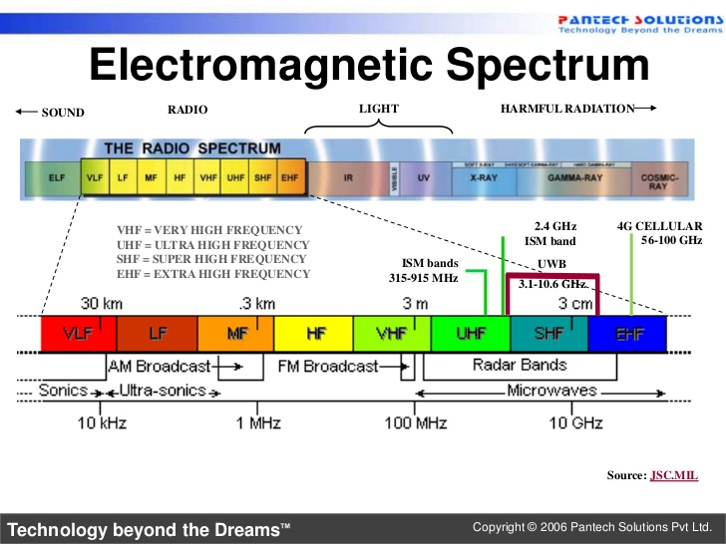
1.<number>
Notes:
UWB: Ultra-Wide Bandwidth
1.#

Slide 5
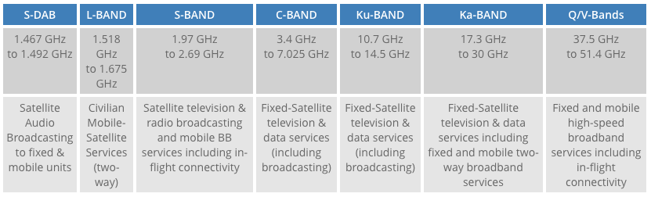
Satellite Communication
1.<number>

Slide 6

Figure 1.1 Five components of data communication
The effectiveness of a data communications:
^{Delivery:}
The system must deliver data to the correct destination
^{Accuracy:}
The system must deliver the data accurately.
^{Timeliness:}
The system must deliver data in a timely manner.
^{Jitter:}
Refers to the variation in the packet arrival time.
1.<number>
Notes:
1.#

Slide 7

Figure 1.2 Data flow (simplex, half-duplex, and full-duplex)
1.<number>
Notes:
1.#

Slide 8
1-2 NETWORKS
Network
Set of devices (often referred to as nodes)
Connected by communication links.
Note: A node can be a computer, printer, or any other device capable of sending and/or receiving data generated by other nodes on the network.
Topics discussed in this section:
Distributed Processing
Network Criteria
Physical Structures
Network Models
Categories of Networks
Interconnection of Networks: Internetwork
1.<number>
Notes:
1.#

Slide 9

Figure 1.3 Types of connections: point-to-point and multipoint
1.<number>
Notes:
1.#

Slide 10
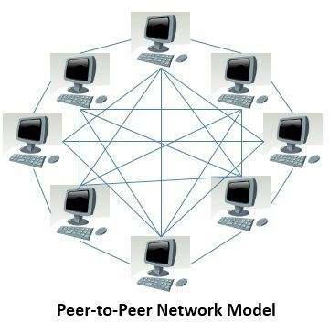
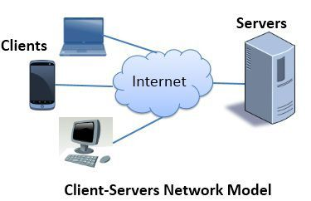
Type of Networks
Peer to Peer:
Each user has its own data and applications
Centeralized:
The data management is centralised
1.<number>
Notes:
1.#

Slide 11

Figure 1.4 Categories of topology
1.<number>
Notes:
1.#

Slide 12

Figure 1.5 A fully connected mesh topology (five devices)
1.<number>
Notes:
1.#

Slide 13

Figure 1.6 A star topology connecting four stations
1.<number>
Notes:
1.#

Slide 14

Figure 1.7 A bus topology connecting three stations
1.<number>
Notes:
1.#

Slide 15

Figure 1.8 A ring topology connecting six stations
1.<number>
Notes:
1.#

Slide 16

Figure 1.9 A hybrid topology: a star backbone with three bus networks
1.<number>
Notes:
1.#

Slide 17

Figure 1.10 An isolated LAN connecting 12 computers to a hub in a closet
1.<number>
Notes:
1.#

Slide 18
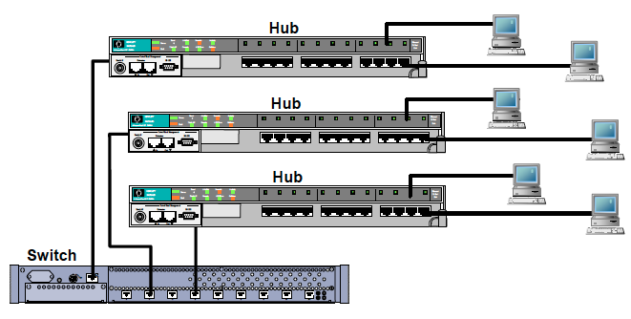
1.<number>

Slide 19

Figure 1.11 WANs: a switched WAN and a point-to-point WAN
1.<number>
Notes:
1.#

Slide 20

Figure 1.12 A heterogeneous network made of four WANs and two LANs
1.<number>
Notes:
1.#

Slide 21
1-3 THE INTERNET
Internet
Network of Networks
Revolutionized many aspects of our daily lives.
It has affected the way we do business
Affected the way we spend our leisure time.
Topics discussed in this section:
A Brief History
The Internet Today (ISPs)
1.<number>
Notes:
1.#

Slide 22

Figure 1.13 Hierarchical organization of the Internet
1.<number>
Notes:
1.#
NAP: Network Access Point

Slide 23
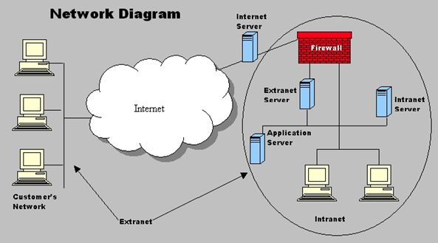
Intranet vs Extranet vs Internet
Src: http://i.stack.imgur.com/NQTOH.png
1.<number>
Notes:
Intranet= Private Network , similar to internet but only accessible within organization
Extranet=Used by different businesses for private sharing of information
1.#

